Slide 1
Braillo-Phone Integrated Communication Software for Visually Challenged and Hearing Impaired
PANIMALAR ENGINEERING COLLEGE
Department of CSE
Domain - Machine Learning
TEAM MEMBERS
Soniya K (211417104264)
Sophia Grace Lydia D (211417104265)
Vishnu Priya S (211417104305)
GUIDE
Dr. D. Anuradha,
M.E., PGDBA., Ph.D,
Supervisor, Professor – CSE Department

Slide 2
ABSTRACT
From the olden days, Deaf-Blind people have used tactile sign language and braille to communicate with others. Currently, there are many technologies and devices for braille communication such as tellatouch, telebraille, and screen braille in which a deaf-blind person can read or write. However, since these devices are not portable, they face great difficulties in communicating with those who don't know braille during their travel.
Our proposed system is a device that converts human speech into braille text and vice versa. The device will contain a refreshable braille display and a Braille keypad with a microphone. The speech is given as input to the device through a microphone and speech is converted to braille text then displayed on the braille display which can be read by the blind person through contact. The blind person can communicate using a braille keypad whose input braille will be converted to human speech. Our device will help visually and hearing-impaired people to conveniently communicate, for educational purposes, and with others at convenience stores, shopping malls, and other areas.

Slide 3
LITERATURE REVIEW
S.No | Title | Publication | Author | Description
1 | The method of Feature Extraction in Automatic Speech Recognition System for Machine Interaction with Humans. | International Journal of Scientific & Engineering Research, Volume 6, Issue 5, May-2015 143ISSN 2229-5518 | Kishori R. Ghule, R. R. Deshmukh | This paper will explains how the speech signal is converted into text format. It uses Acoustic Phonetic Approach, Pattern Recognition Approach, computing Approach for speech recognition system.
2 | Voice Recognition System: Speech-to-text | November 2015Journal of Applied and Fundamental Sciences 1(2):2395-5562 | Prerana Das’s, Vijay Prasad | This paper will explains how the speech signal is converted into text format. It consist of two part feature extraction and classification.
3 | A Review of Kannada Text to Braille Conversion | International Journal of Engineering Science and Computing, January 2018 | Meenakumar, V.Umarani, Raghavendra, P.Sheddi | This algorithm maps each Kannada character to its equivalent braille character. It gives 100% accuracy in transliteration between braille and Kannada.
4 | Aiding the visually impaired: Developing an efficient braille printer | IEEE accepted paper (not published yet) International Conference on Advances in Computing, Communications and Informatics (ICACCI-2017 | Anubhav Apurva, Palash Thakur, Anupam Misra. | There is no common interface between normal people and visually challenged. Braille Printer is a device which provide such common interface.. Braille Printer takes an input as a speech through microphone which is then converted to text using speech recognition and the recognized text is embossed in its respective Braille code.
5 | A Relatively High-Resolution Reading Aid for the Blind. | IEEE Transactions on Man-Machine Systems ( Volume: 10, Issue: 1, March 1969) | James C. Bliss | This paper describes how we going to employ an auditory output consisting of a combination of tones indicating the black regions in a vertical slice through a letter space, or a tactile output consisting of a raised or vibrating image of the letter shapes

Slide 4
TECHNOLOGY STACK
SOFTWARE
HARDWARE
Speech recognition Toolkit: Kaldi5.5
Dataset: Vosk API, Kaldi dataset
Software: Visual Studio
Version : Python 3.0,pip3
OS: Windows 10
RAM: 8 Gb
Processor: intel i3
Hard Disk: 500Gb
Hardware: Micro servo motor ,Arduino

Slide 5
PROPOSED SYSTEM
Today, there are many systems to facilitate the communication between a deaf-blind person with others however all of them translate text input into braille. Our system aims to convert human speech is converted to braille and vice versa. It is a device comprising of a microphone, a braille keypad, and a refreshable braille display.
The input speech is first converted to English text using speech recognition. The Mel-Frequency Cepstral Coefficient (MFCC) is used for feature extraction and Minimum Distance Classifier, Support Vector Machine (SVM) methods are used for speech classification.
This text is converted to braille by mapping each English character symbol to the corresponding braille Unicode character according to the rules of braille. The refreshable braille display will be powered using Arduino and Micro servo motor SG90. The braille-phone hardware device will get the converted braille characters as input and display the output via refreshable braille-phone.

Slide 6
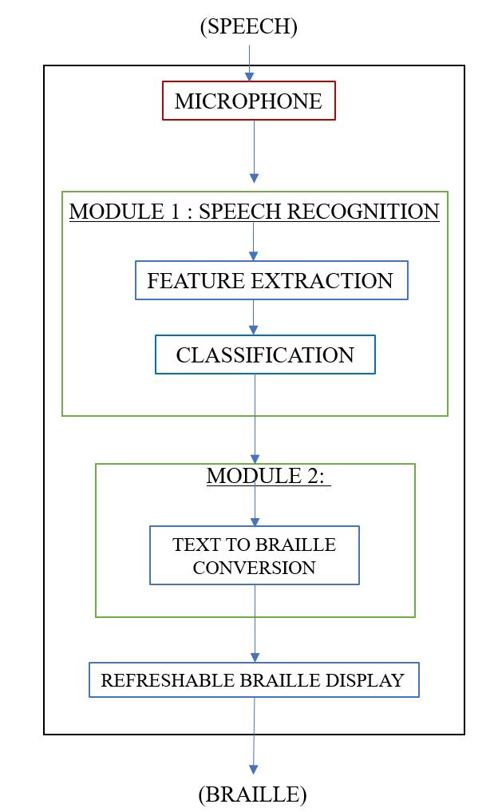
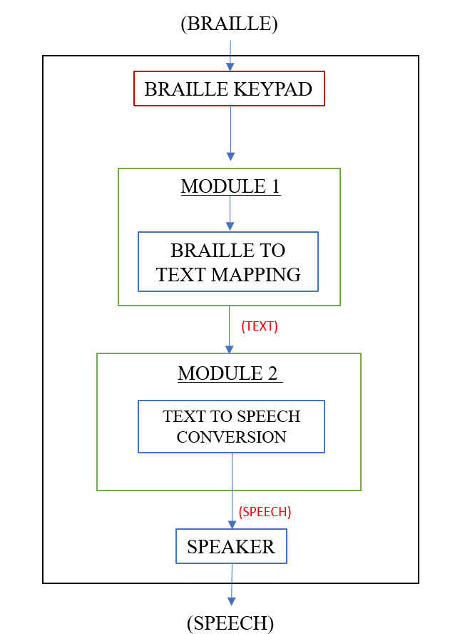
FLOW CHART
Speech to Braille Conversion
Braille to Speech Conversion

Slide 7
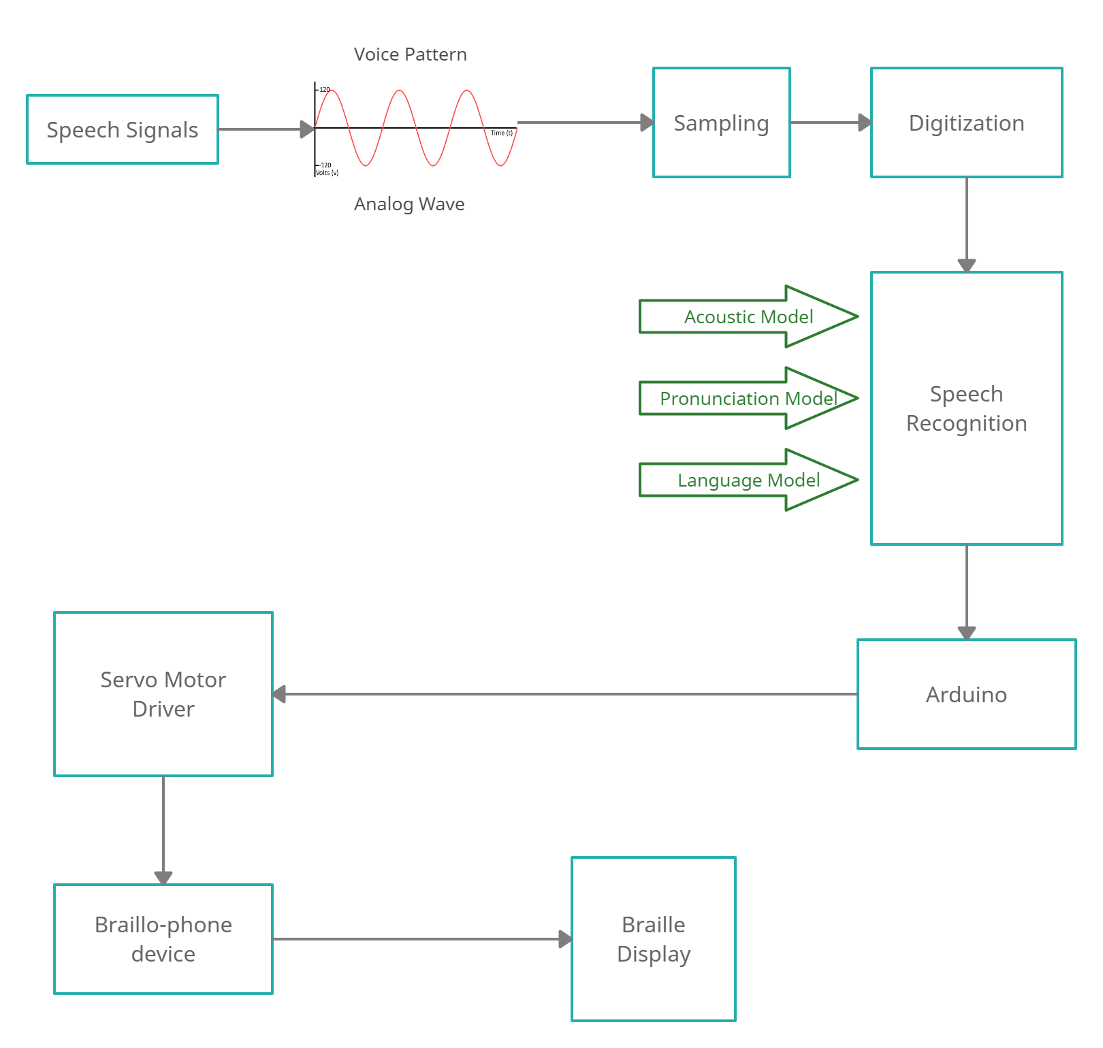
SYSTEM ARCHITECTURE

Slide 8
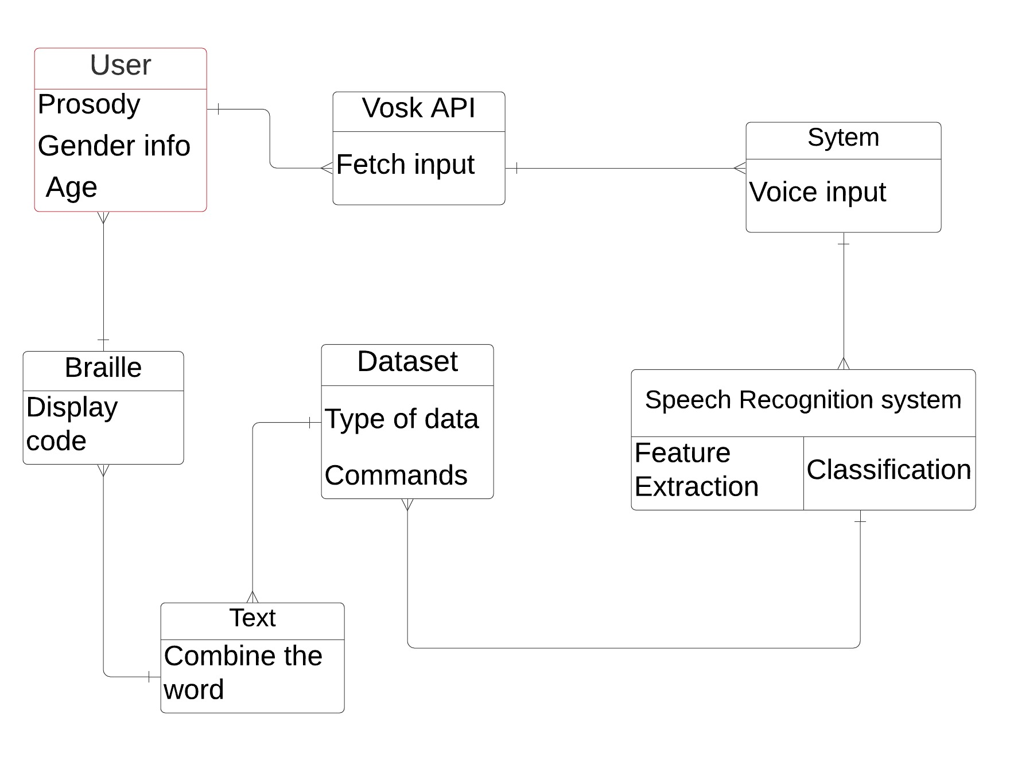
CLASS DIAGRAM

Slide 9
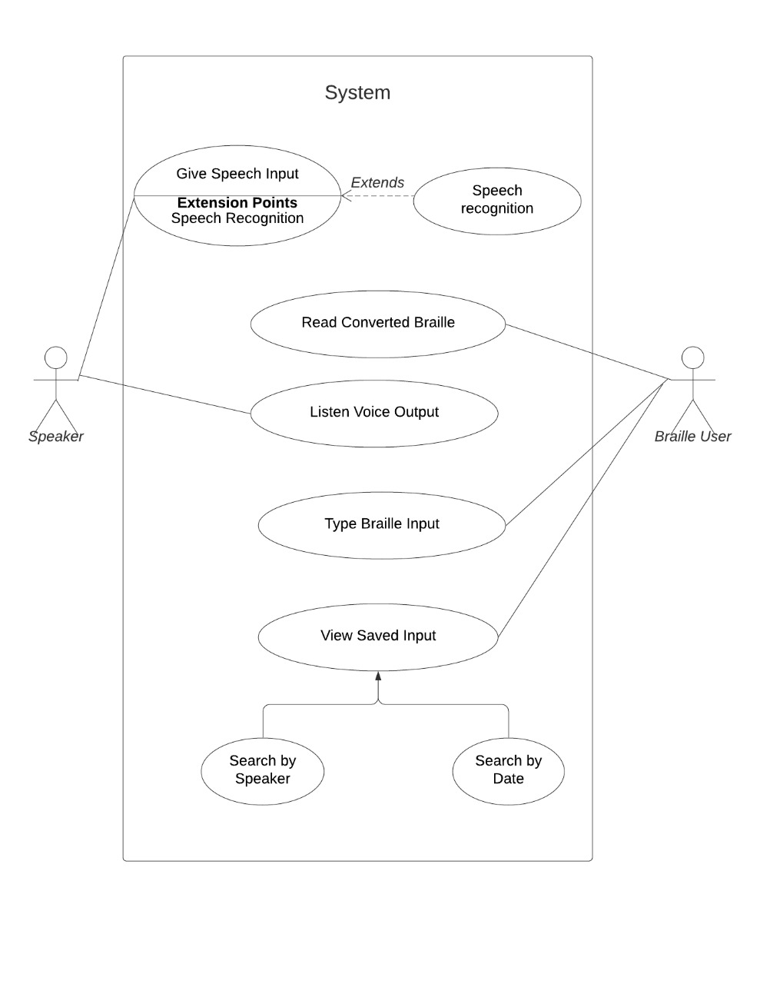
USE CASE DIAGRAM

Slide 10
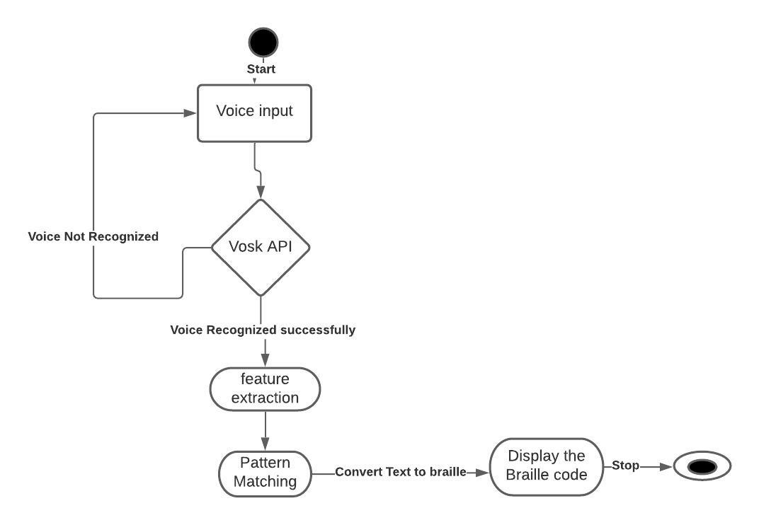
STATE DIAGRAM

Slide 11
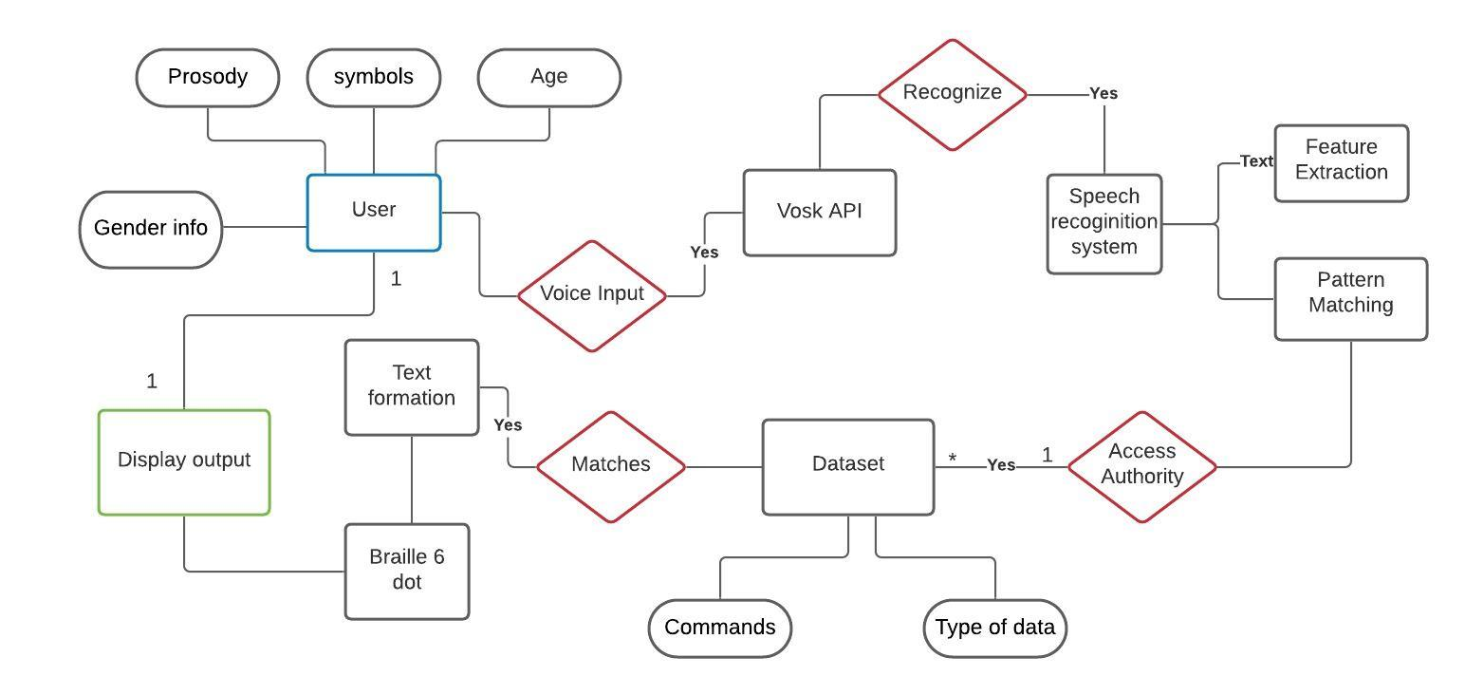
ER DIAGRAM

Slide 12
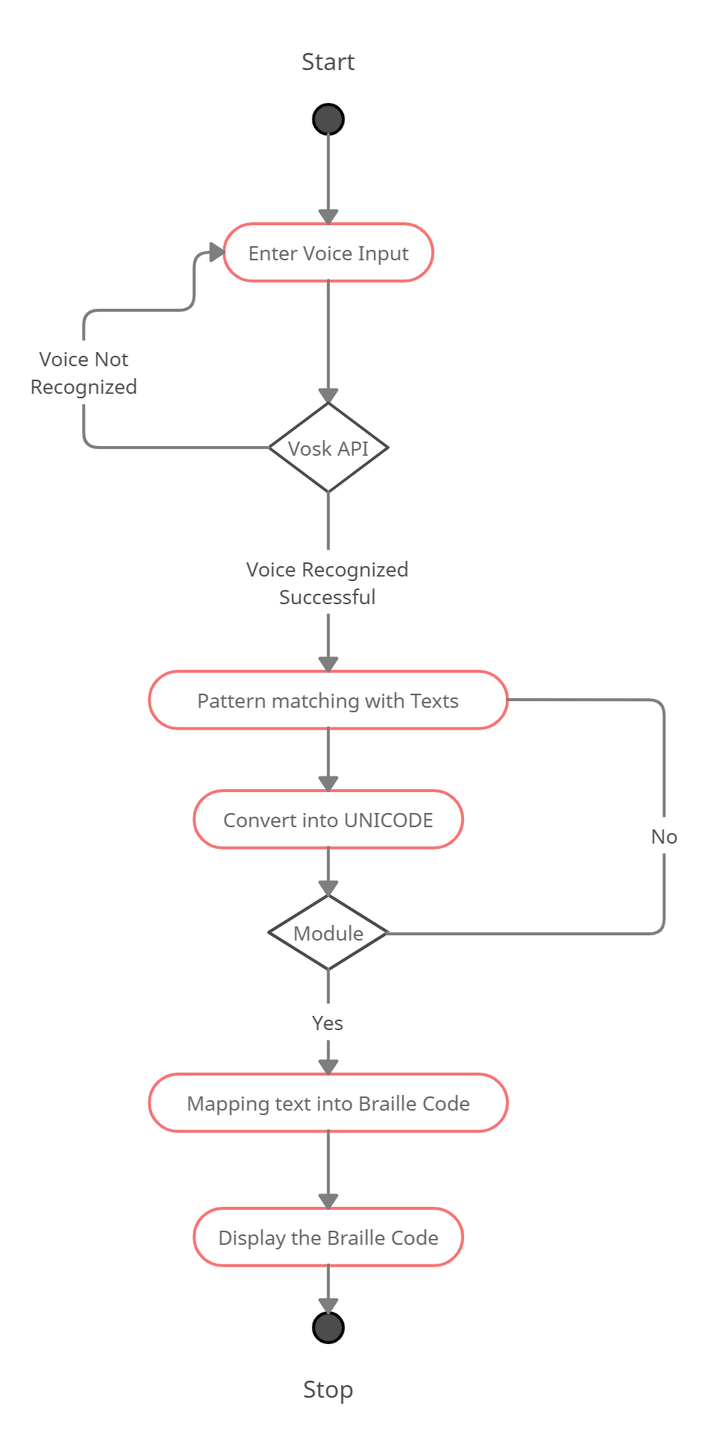
ACTIVITY DIAGRAM

Slide 13
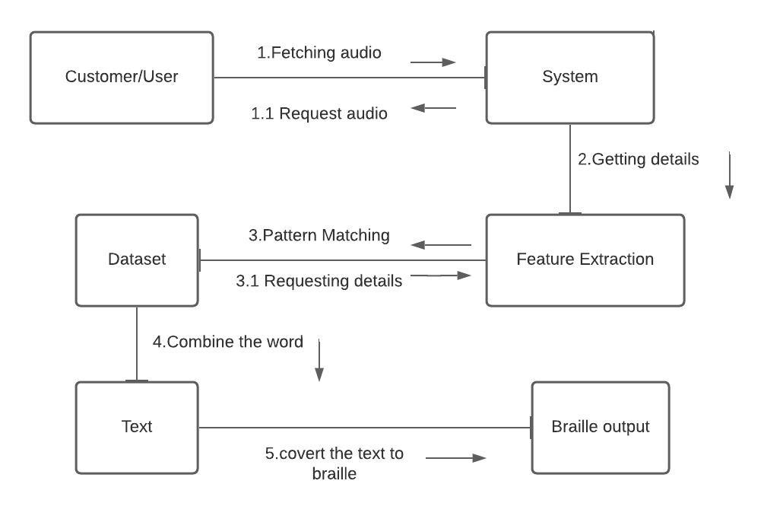
COLLABORATION DIAGRAM

Slide 14
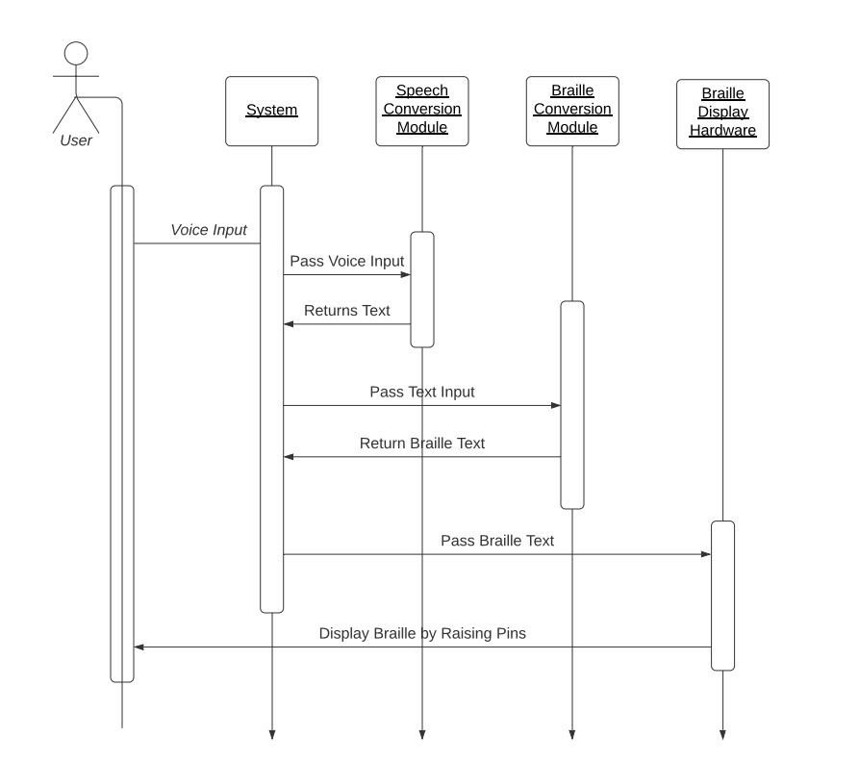
SEQUENCE DIAGRAM

Slide 15
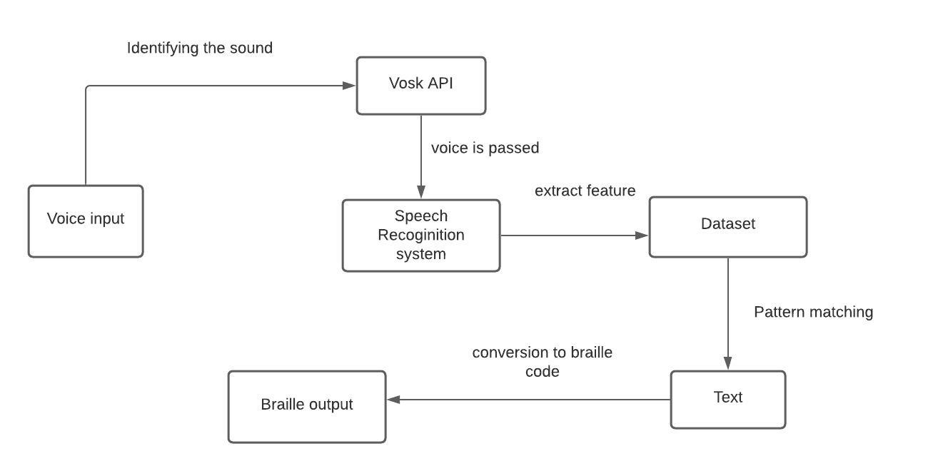
INTERFACE DIAGRAM

Slide 16
NOVELTY
Due to dual sensory hardship, visual and hearing-impaired people are led to many difficulties while interacting with a normal person in the world, without an assistant or support they can’t communicate with others.
The currently existing braille devices for the blind people is only based on conversion of texts into braille output. Our idea of approach will also provide the user with an option to accept voice as an input, which can further be converted into braille. This will additionally helps the user comfortable to have a common conversation in the public areas of interaction.

Slide 17
SOCIAL BENEFITS
Our Braillo-phone device is portable and easy to travel.
visually and hearing-impaired people to conveniently communicate with others at convenience stores, shopping malls, and other areas.
Braillo-Phone can be used in Education for the dually challenged people.
It can provide a safe environment for patients to come into contact with common people.
Also be used in medical and pharmaceutical industry to have a better communication.

Slide 18
MODULES
Speech Signal
~Acoustic phonetic symbols
~Prosody
~Gender information
~Age
~Accent
Speech Recognition
Feature Extraction [retaining necessary information of the speech signal while rejecting the unwanted]
2) Pattern Recognition [After the extraction of necessary features from the speech samples, pattern matching or classification will be done in most speech processing applications]
Algorithm
~MFCC (Mel Frequency Cepstral Coefficients
~SVM (Support Vector Machines)
Text-Braille
~Translates each character by converting into corresponding braille Unicode character
Flow Chart
Speech Recognition
Speaker Recognition
Coding Digitization
Speech Enchancement

Slide 19
Collection of Vosk dataset for language identification
The initial phase - configure the database.
Implemented - with the help of the python module for Vosk API to recognize the speech given by the user to the system.
Vosk API
Focuses on life-long semi-supervised learning modules with huge datasets.
Enables speech recognition models for over 17 languages, dialects and also provides continuous large vocabulary transcription.
Corresponding braille characters to the compound English words
convert the compound English words into their respective braille characters.
Each and every word is matched with the corresponding braille Unicode and then braille characters are obtained.
EXAMPLE - sentence "Good Job"
The letter 'G' is converted into the braille UNICODE value say 111100. Then the UNICODE value is mapped with its braille character ⠛ (braille pattern dots-1245).
UNICODE value into Braille characters
Alphabets | Braille UNICODE Value | Braille Character
G | 111100 | ⠛
O | 100110 | ⠕
O | 100110 | ⠕
D | 110100 | ⠙
J | 011100 | ⠚
O | 100110 | ⠕
B | 101000 | ⠃

Slide 20
Braillo-phone device for braille characters display
Through the micro servo motor connected with Arduino, the code is embedded and displays the braille characters for the understanding of the visual and hearing-impaired people.
This device is built with a sparse error percentage and great efficiency.
This device is implemented using a Single Board Computer Audrino, as it is portable and practices Real-time experiments.
Successfully achieved the output of 100% accuracy
English words into Braille table
Sr.no | English words matching the speech signals | Corresponding Braille characters
1 | World | ⠺⠕⠗⠇⠙
2 | How are you | ⠓⠕⠺ ⠁⠗⠑ ⠽
3 | Good Morning | ⠛⠕⠕⠙ ⠍⠕⠗⠝⠊⠝⠛
4 | Welcome | ⠺⠑⠇⠉⠕⠍⠑
5 | Have a nice day | ⠓ ⠁ ⠝⠊⠉⠑ ⠙⠁⠽
6 | Reading | ⠗⠑⠁⠙⠊⠝⠛
7 | Guide me | ⠛⠥⠊⠙⠑ ⠍⠑
8 | All the very best | ⠁⠇⠇ ⠮ ⠧ ⠃⠑⠎⠞
9 | Oh my God | ⠕⠓ ⠍⠽ ⠛⠕⠙
10 | Can you Wait | ⠉ ⠽ ⠺⠁⠊⠞

Slide 21
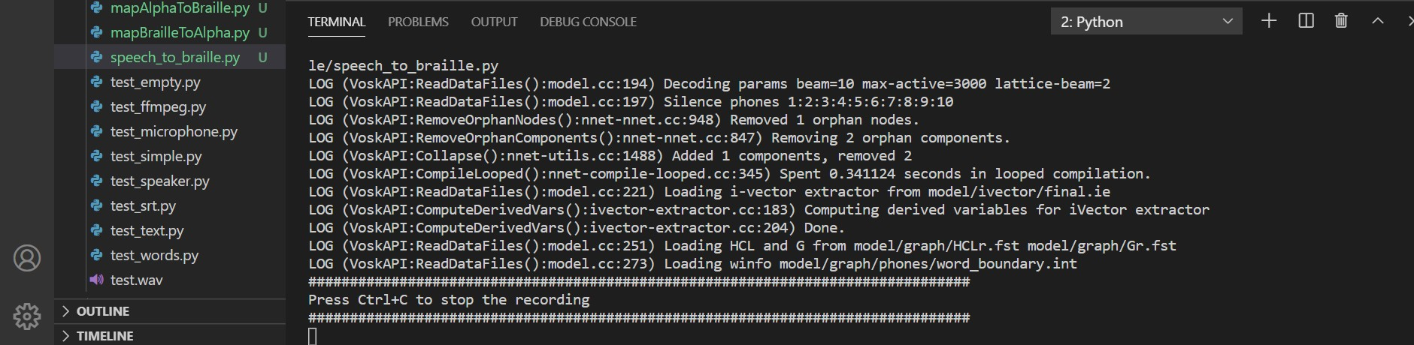
RESULTS
Fig. 1 An instance initiating the software to get the user input.

Slide 22
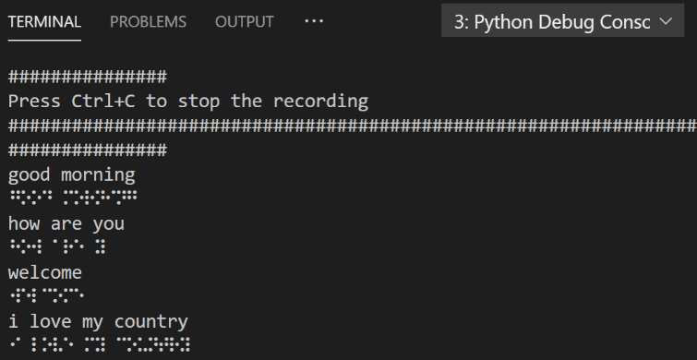
RESULTS
Fig. 2 An instance showing the mapping of an alphabet to Braille words.

Slide 23
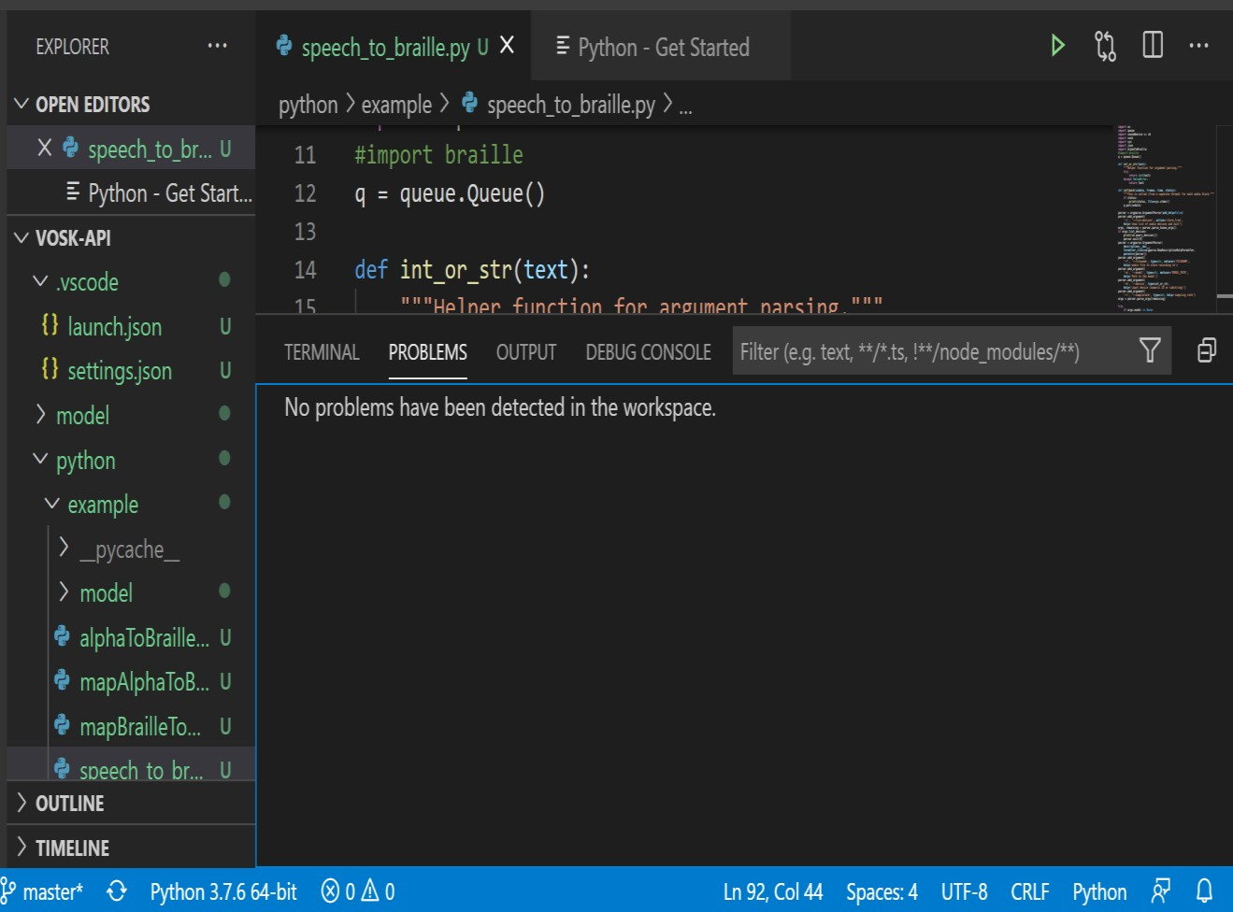
RESULTS
Fig. 3 Status of the Output Generated.

Slide 24
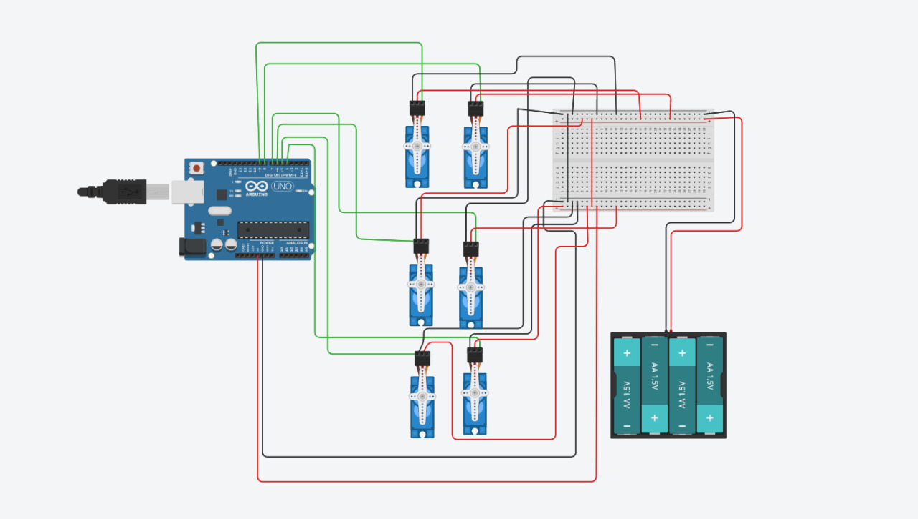
HARDWARE
Servo motor:
•Servo Motor helps us to control the rotational or linear speed and the position.
•This motor is controlled through an electrical signal, either analog or digital for which help us to determine the amount of movement.
• It is mainly used on angular or linear position and for specific velocity, and acceleration.
Our work:
•Normally braille system consists of six dots. In this process we are going to connect each dot to one servo motor respectively.
•The input in the text form is fetched from the software.
•For each and every character corresponding servo motor rotate.
•It will act like a keypad for displaying braille output to the visually challenged people.
For example:
for the letter “E” the corresponding servo motor will rotate this will turn to rise the letter upward so that the braille person can touch and know what is the exact letter.

Slide 25
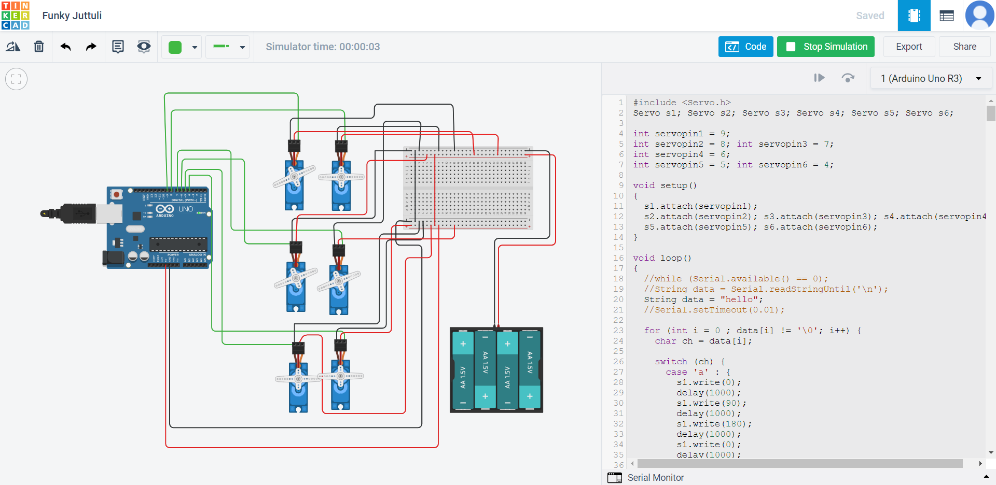
RESULTS

Slide 26

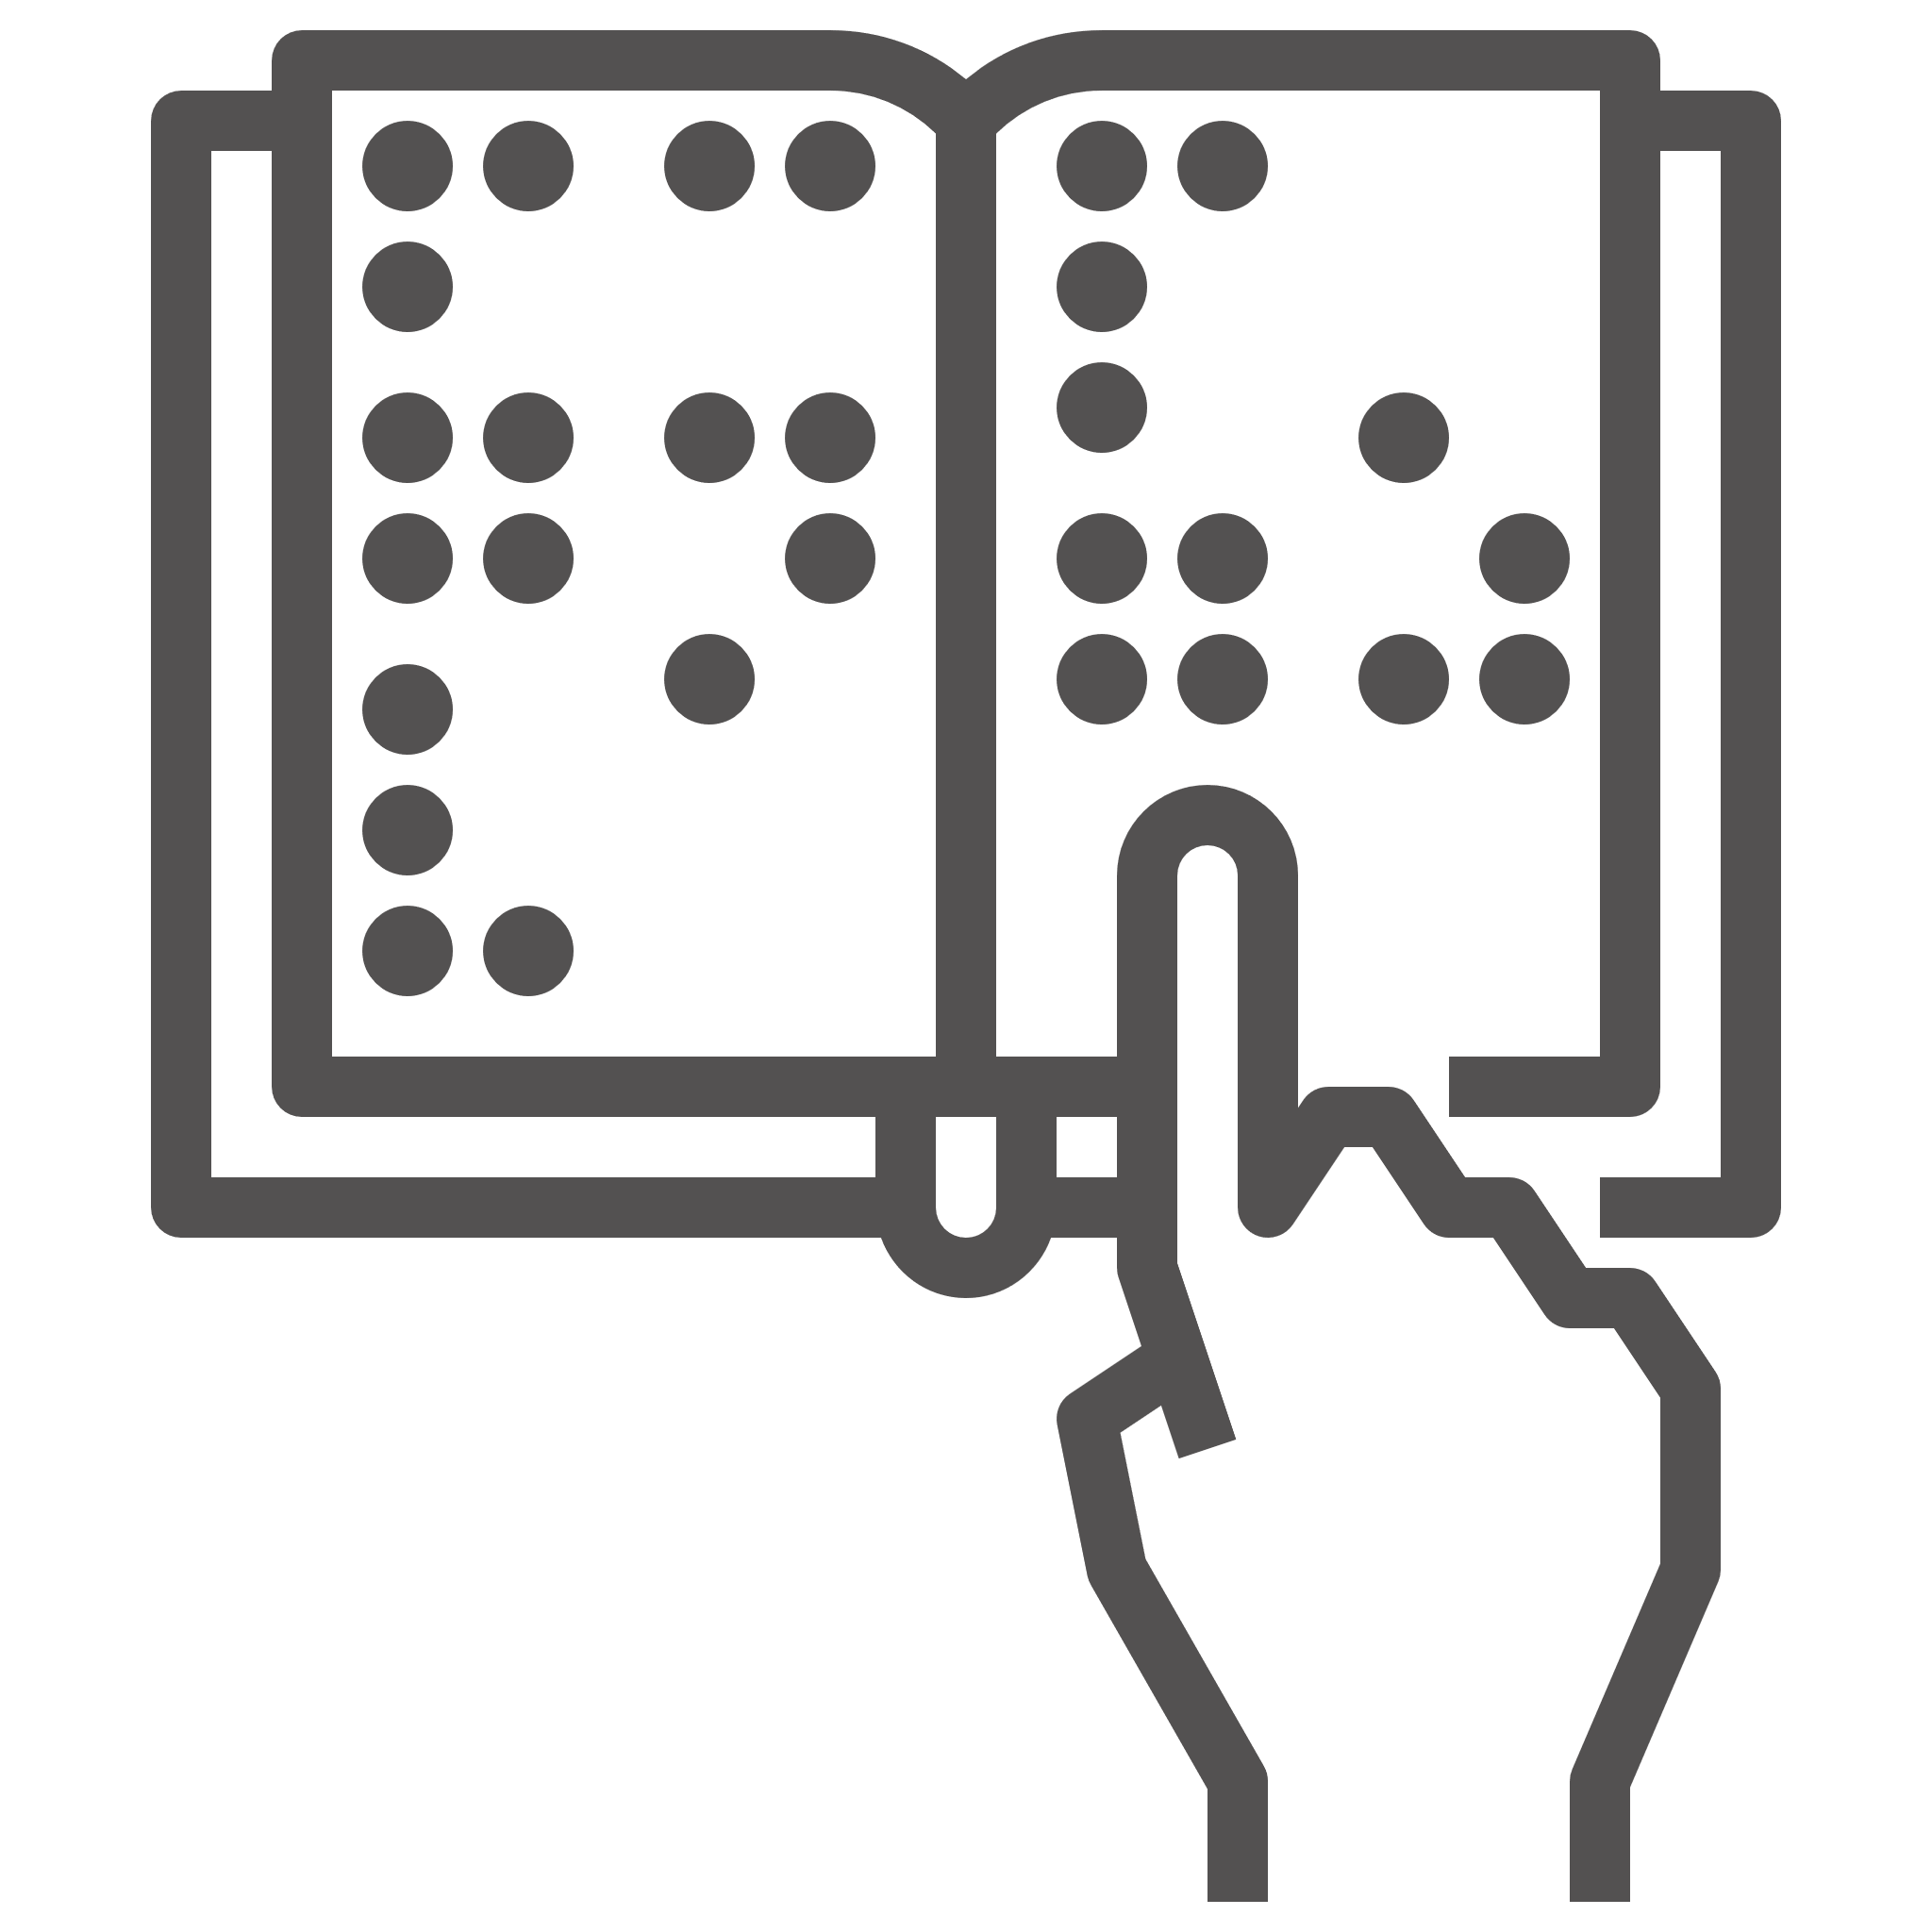
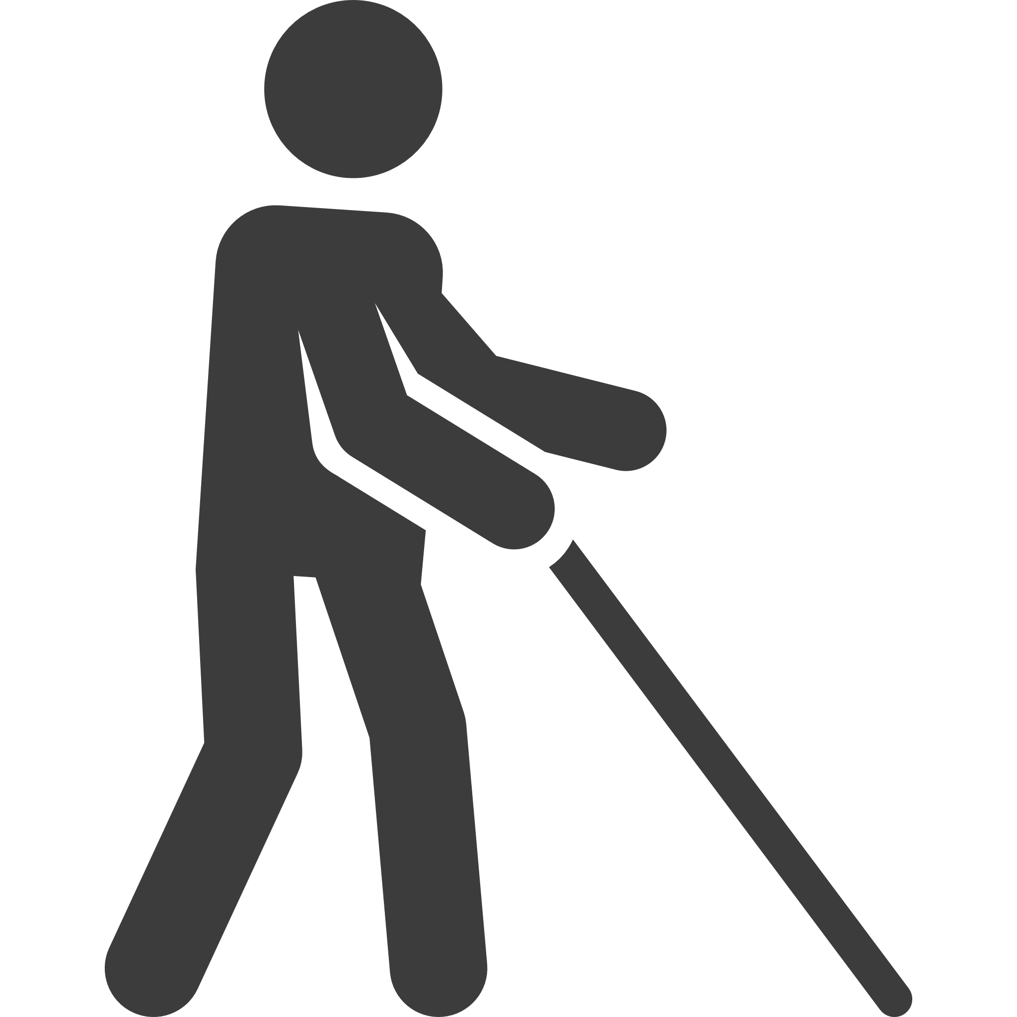

Thank you

